Slide 1

FRONT END ENGINEERING-I
PROJECT
TTeeaamm DDeettaaiillss: Group no:G27-A
Prisha Aggarwal- 2210990682
Pritam kumar- 2210990683
Priyansh Arora- 2210990684
Priyanshu- 2210990685
FFaaccuullttyy CCoooorrddiinnaattoorr: Dr. Mandeep Kaur
:
CCHHIITTKKAARRAA UUNNIIVVEERRSSIITTYY IINNSSTTIITTUUTTEE OOFF EENNGGIINNEEEERRIINNGG AANNDD TTEECCHHNNOOLLOOGGYY,,
CCHHIITTKKAARRAA UUNNIIVVEERRSSIITTYY,, PPUUNNJJAAB

Slide 2
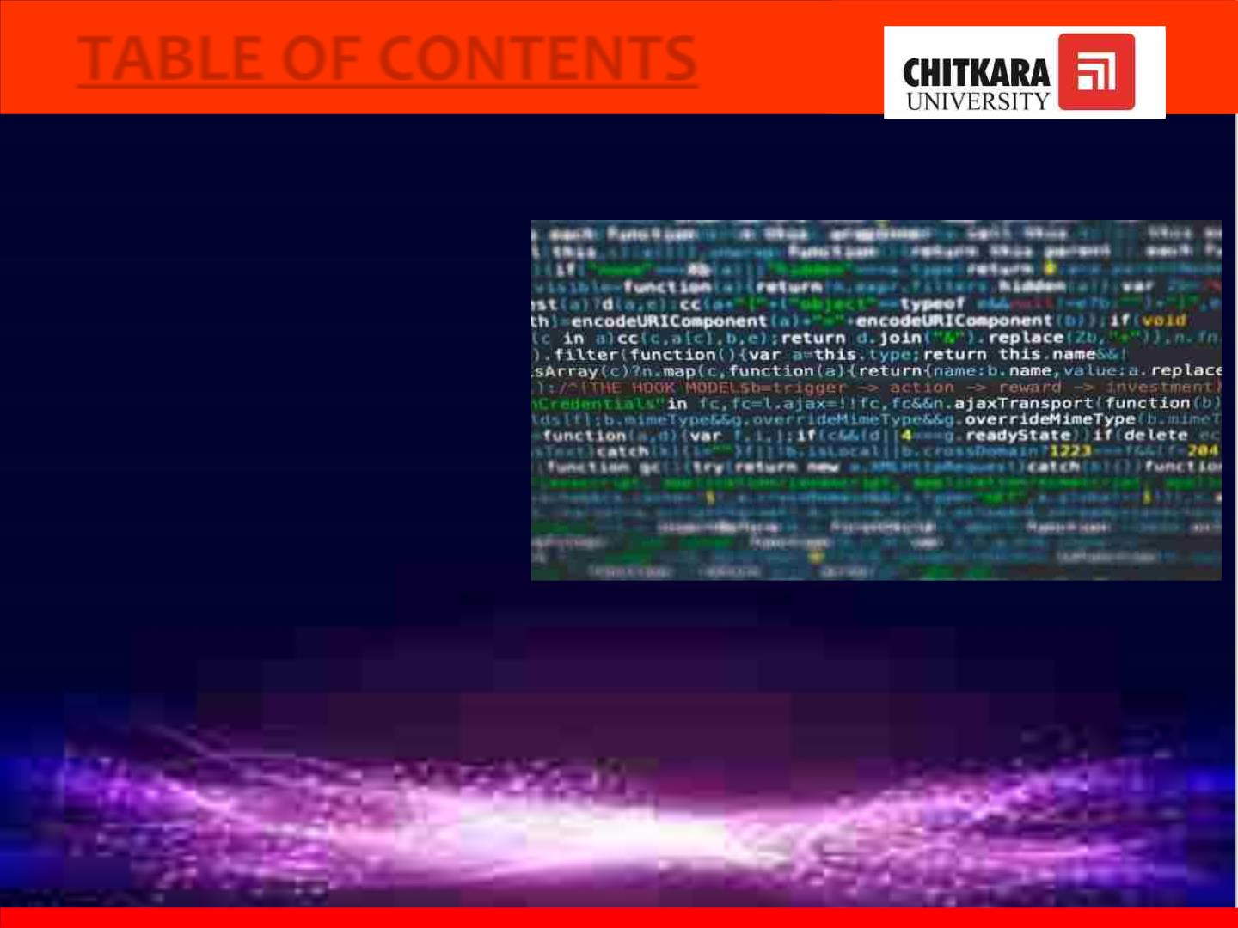
TABLE OF CONTENTS
1. Introduction
2. Problem Statement
3. Technical Details
4. Key Features
5. Project Highlights
6. Conclusion
7. References/Links used

Slide 3

INTRODUCTION
PPrroojjeecctt TTiittllee: NOTELOG
TTeeaamm mmeemmbbeerrss : Prisha Aggarwal- 2210990682
Pritam kumar - 2210990683
Priyansh Arora - 2210990684
Priyanshu
- 2210990685
• This project emphasizes the importance of note log in our daily lives for
accessing information quickly and storing your heart contents safely and
efficiently.
• We have created a note log frontend that looks and feels like a real time
experience. Users can simply enter what they want to write in the note and it will
be saved.

Slide 4

• The project aims to provide a visually appealing and user-friendly note log that
delivers a natural paper and pen experience for users.
• This project is our method to provide users their much needed privacy and let
them write to their hearts content.
• In this project , we have taken inspiration from many popular note log
sites such as evernote, simple note or even some blogging sites.

Slide 5

PROBLEM STATEMENT
• A project to help the users in tracking events and resolving messy calendars
or diaries.
• A short and descriptive place to arrange the tasks.
• To-do lists
• Organize and prioritize some tasks.

Slide 6
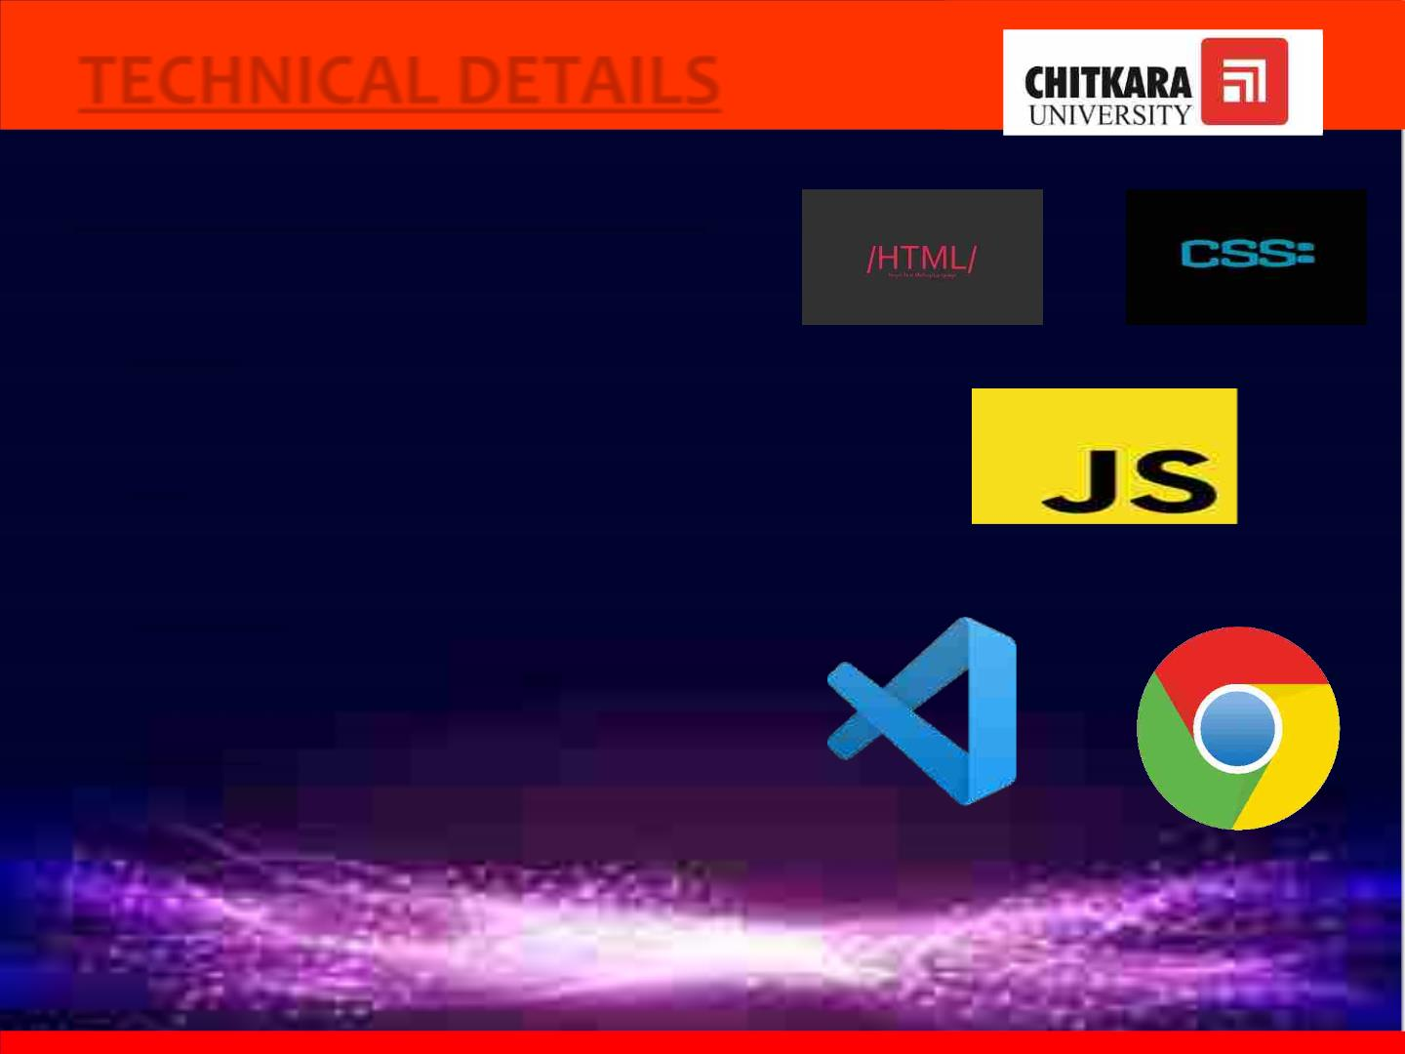
TECHNICAL DETAILS
FFoolllloowwiinngg tteecchhnnoollooggiieess hhaavvee bbeeeenn uusseedd ::
1. HHTTMMLL- the basic layout of the website
2. CCSSSS- style and design of the website
3. JJaavvaassccrriipptt : develop the web page
4. VVSS CCooddee- code editor
5. CChhrroommee – for hosting the website

Slide 7

KEY FEATURES
• Note taking is an efficient way of organizing tasks or information that has
been collected.
• Due to busy schedule, users tend to forget certain important tasks or
information. So they can save them here on Notelog and can access them
anytime.
• Instead of using the traditional way of taking notes, it allows users to store
notes digitally thus saving the environment too.
• All the notes are saved at one place along with the dates for the convenience
of the user.

Slide 8
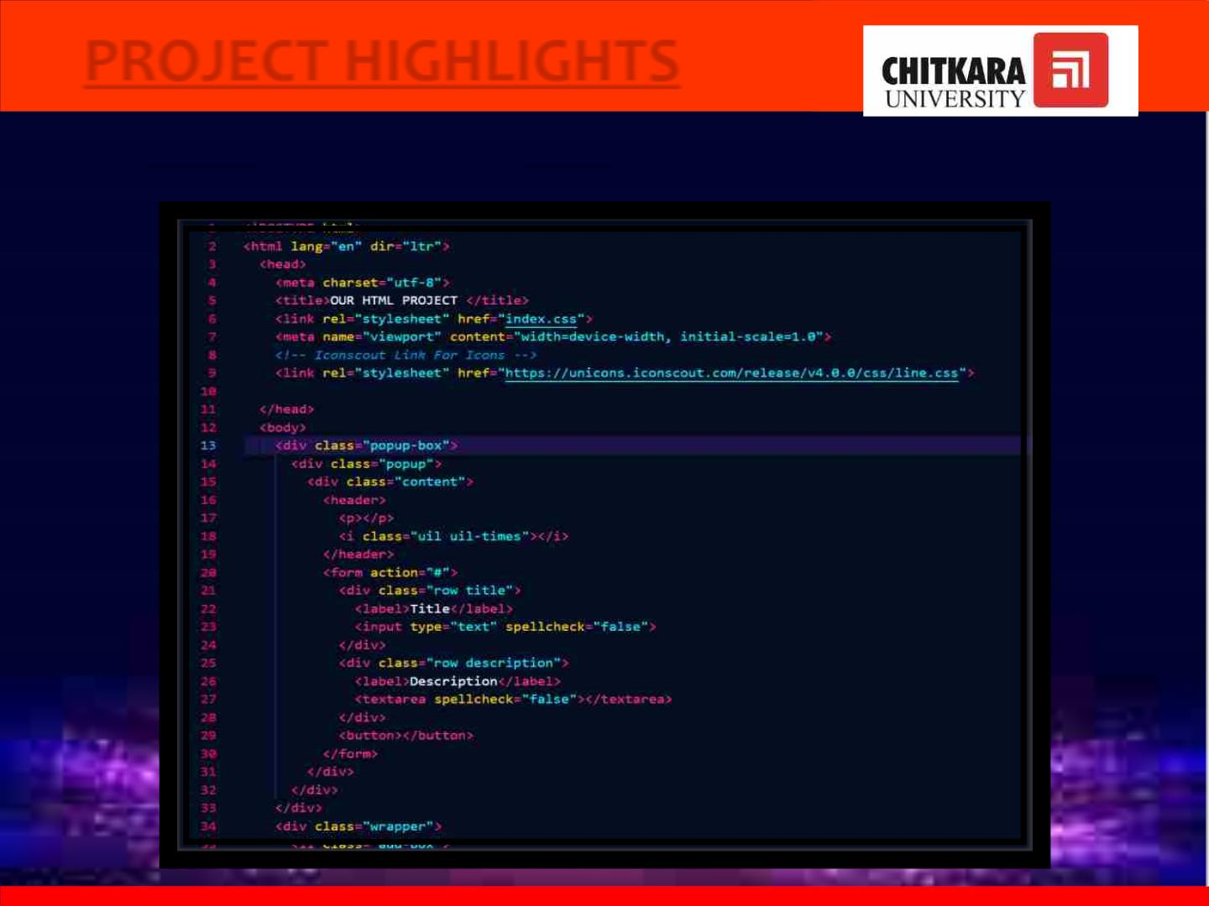
PROJECT HIGHLIGHTS
CCOODDEE ----
HHTTMMLL

Slide 9
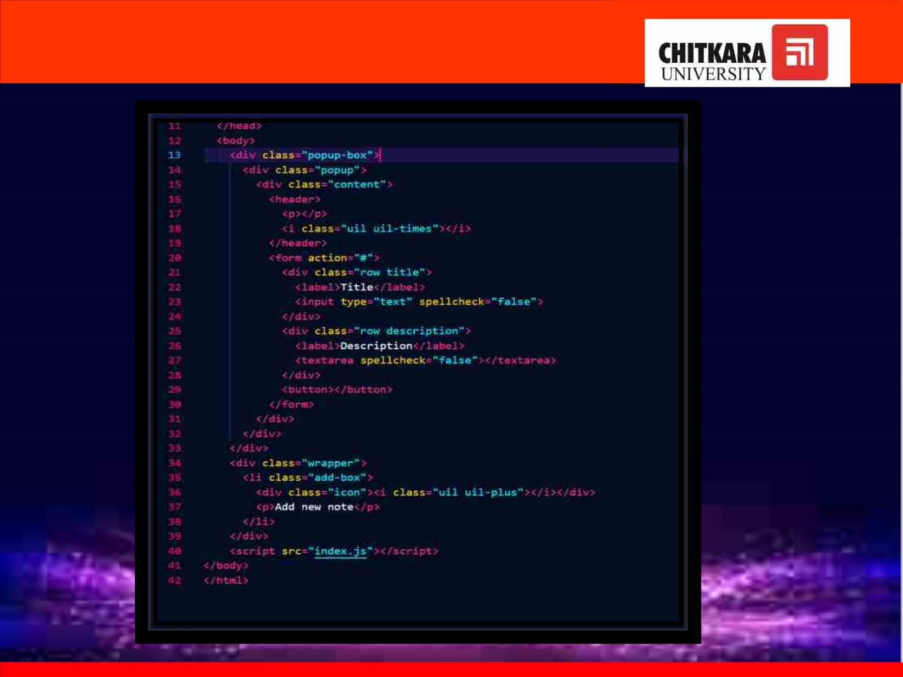

Slide 10

HTML
• html stands for hypertext markup language. it is used to design
web pages using the markup language. html is the combination
of hypertext and markup language. hypertext defines the link
between the web pages and markup language defines the text
document within the tag that define the structure of web pages
• It is user friendly , simple to use and has a definitive structure

Slide 11
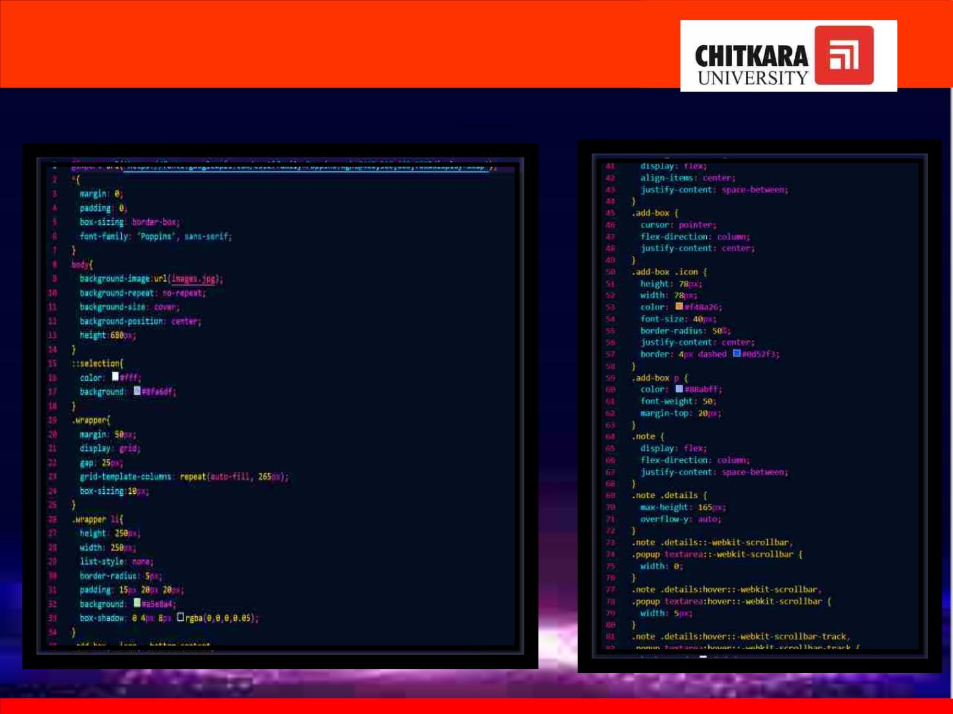
CCSSSS

Slide 12
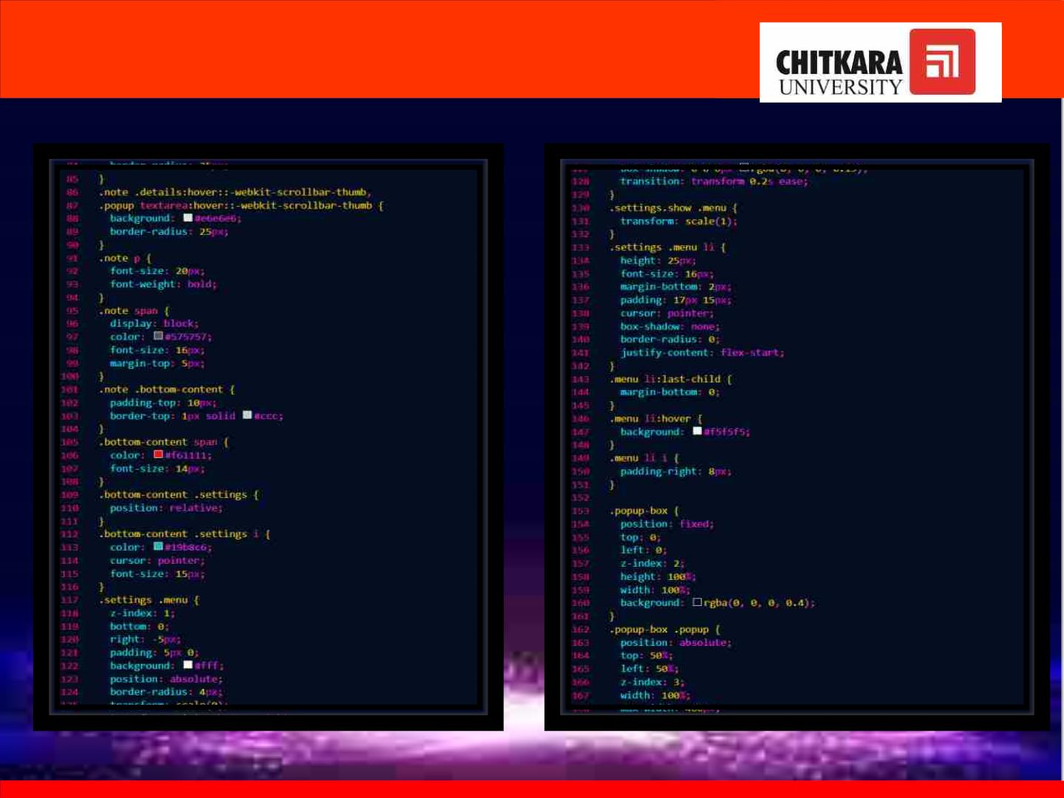

Slide 13
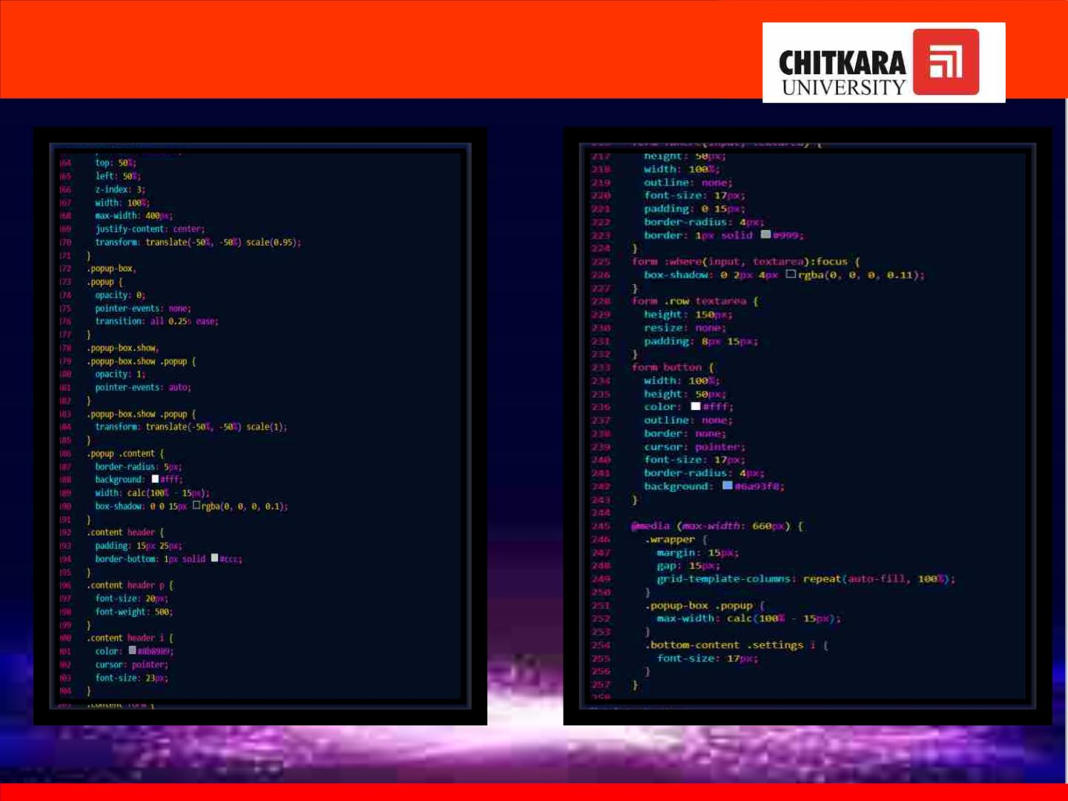

Slide 14

CSS
• cascading style sheets (css) is a simple mechanism for adding
style (e.g., fonts, colors, spacing) to web documents.
• css describes how html elements are to be displayed on screen,
paper, or in other media
• css saves a lot of work. it can control the layout of multiple web
pages all at once
• external stylesheets are stored in css files

Slide 15
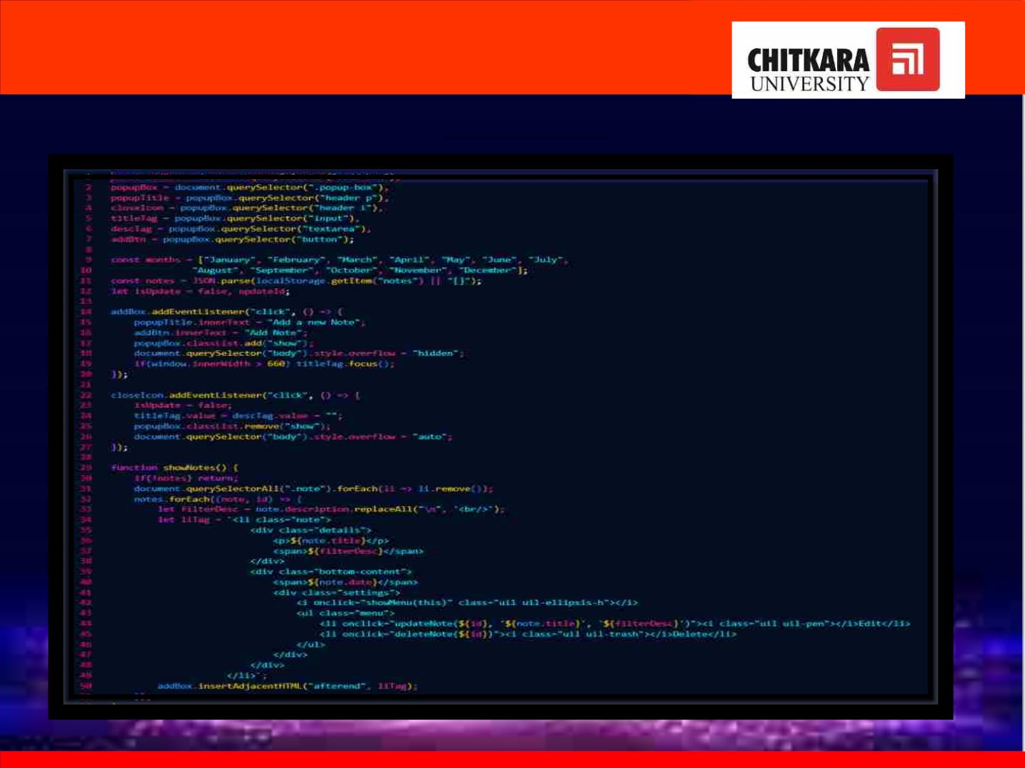
JJAAVVAASSCCRRIIPPTT

Slide 16
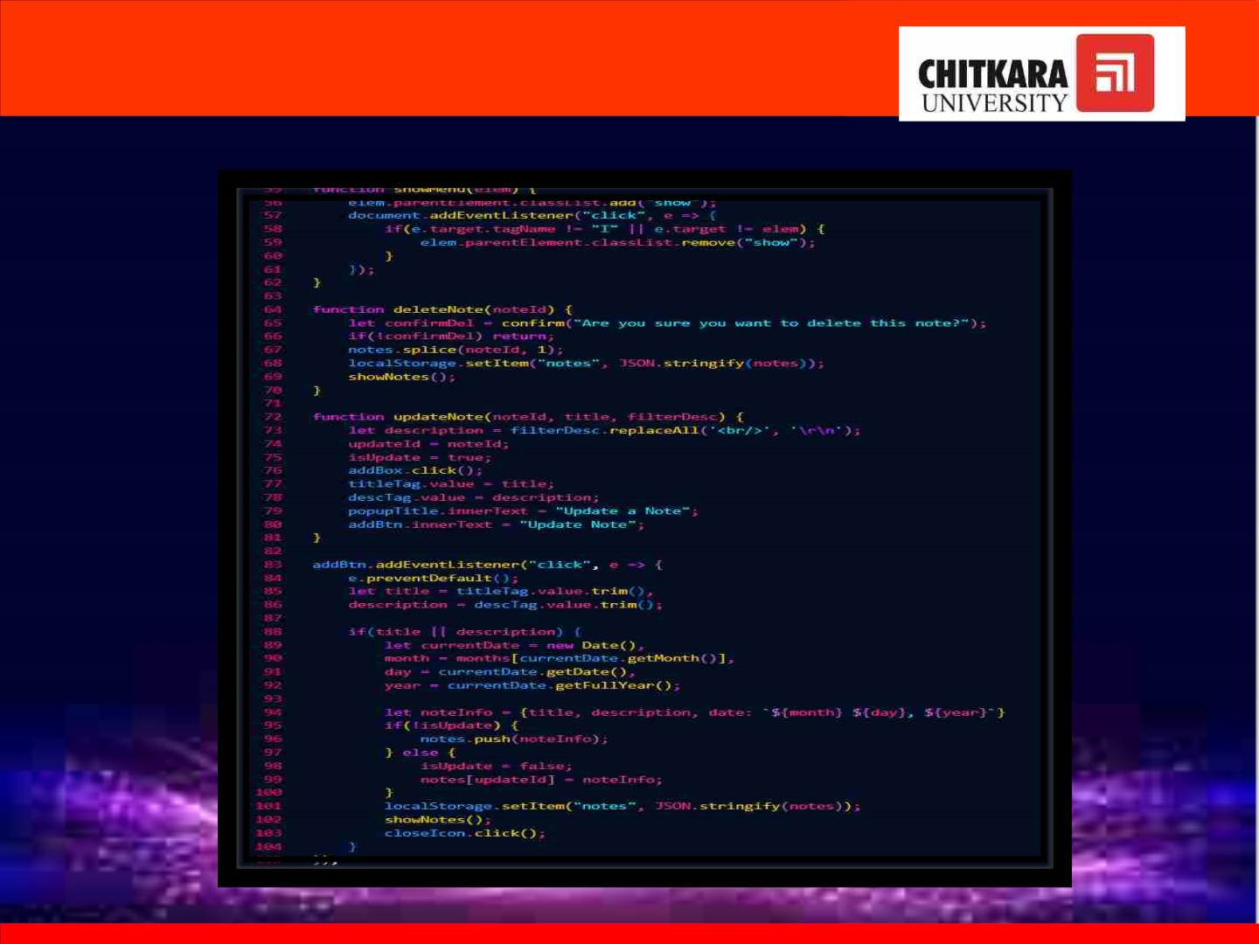

Slide 17

JAVASCRIPT
• javascript is the world's most popular programming language.
• javascript is the programming language of the web.
• javascript is easy to learn.
• while it is most well-known as the scripting language for web pages,
many non-browser environments also use it, such as node.js, apache ,
adobe acrobat use it

Slide 18

WEBSITE FRONT PAGE

Slide 19
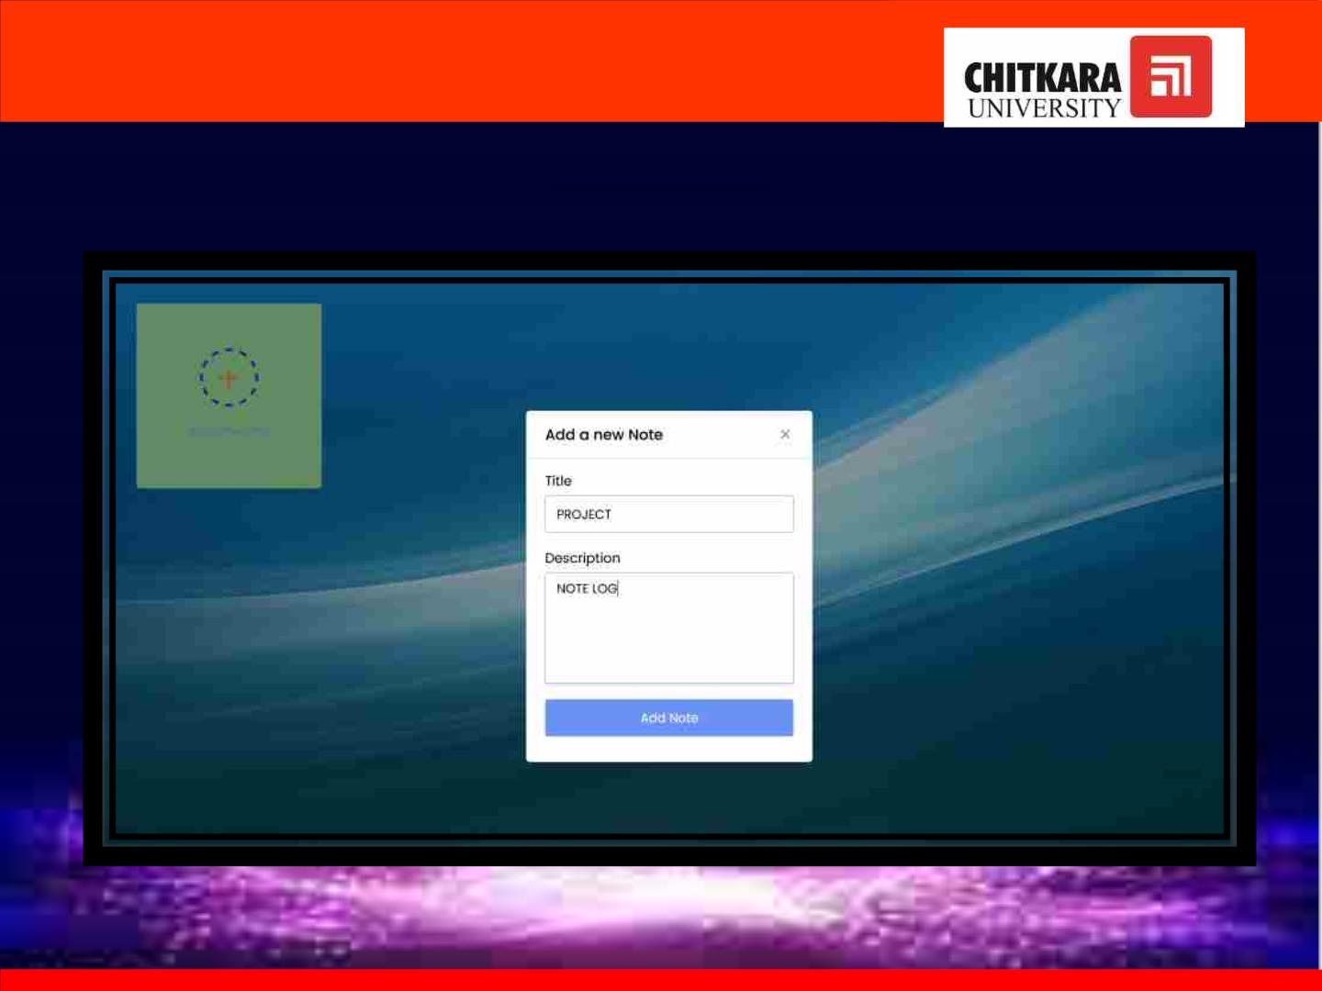
AADDDDIINNGG NNOOTTEE

Slide 20
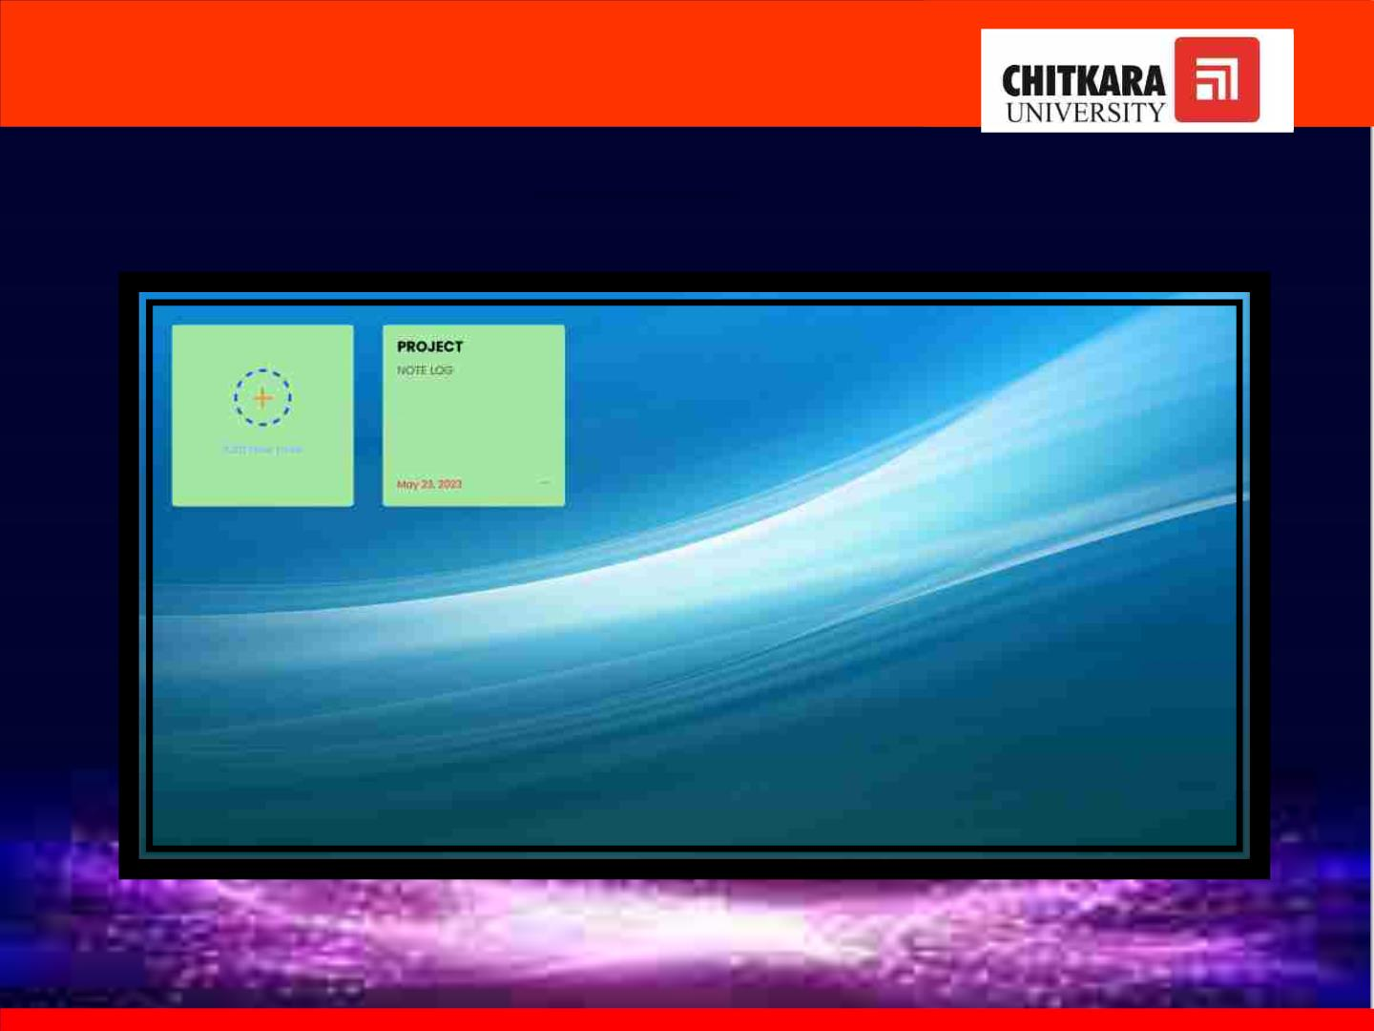
NNOOTTEE AADDDDEEDD

Slide 21

AA VVIIDDEEOO IILLLLUUSSTTRRAATTIINNGG TTHHEE WWEEBBSSIITTEE

Slide 22

REFERENCES
https://www.bing.com/images/search?view=detailV2&ccid=aODXz%2Bic&id=56ED4
B59D047D452FD4BE0C6C4AEB19CCEBF5524&thid=OIP.aODXz-icIk4t-a6o-
WlTAQHaEo&mediaurl=https%3A%2F%2Fwallpapercave.com%2Fwp%2Fwp281476
9.jpg&exph=1199&expw=1919&q=Wallpaper+Background+for+Laptop+HP&simid=60
8033727418026026&form=IRPRST&ck=47B7FA0F5838142EDEEDC2F761984FE4&sele
ctedindex=14&ajaxhist=0&ajaxserp=0&pivotparams=insightsToken%3Dccid_EVNiSgf
e*cp_B2D80AC27157FA354A9B8410616CBD79*mid_56ED4B59D047D452FD4B68B84
E0315F471C16C5C*simid_608036025204737630*thid_OIP.EVNiSgfe!_2ovY40ylu2WjAH
aEK&vt=0&sim=11&iss=VSI&ajaxhist=0&ajaxserp=0
https://fonts.googleapis.com/css2?family=Poppins:wght@400;500;600;700&display=s
wap

Slide 23

CONCLUSION
Notelog is an effective way of taking notes and organizing information. It also
helps in making a to-do list and thus users can plan their day using this notelog
In this project we have used the basic concepts of html, css and js . Through this
project we have implemented and understood various tags and commands that is
used in making a website.

Slide 24


